Slide 1
AI Road Accident detection By using
Data Mining Techniques

Slide 2
TABLE OF CONTENTS
Introduction
Problem Statement
Our solution
Objective
Assumptions and dependencies
System Architecture
Implementation
Model used and selection
References
Data flow
Conclusion
Future of the project

Slide 3
Abstract:
Accident-relatedfatalitiesroad accident detection system leveraging YOLO, a cutting-edge object detection algorithm, to identify accidents in images with high accuracy and speed. The system processes uploaded images through a Flask-based web application, generating annotated visuals and tabular detection summaries. By identifying critical elements like vehicles and debris, it aids in timely accident detection for improved safety measures.
The solution is scalable, user-friendly, and suitable for integration into traffic monitoring and smart city frameworks. This initiative highlights the potential of AI in enhancing road safety and emergency response.

Slide 4
Introduction:
Accident-related fatalities and injuries are predicted to be an increasingly common problem. Since the invention of the vehicle, traffic safety has been a major problem. In India, road accidents claimed the lives of 1,53,972 individuals in total in 2021, according to the Ministry of Road Transport and Highways (MoRTH). Statistics have also shown that young individuals, who make up a significant portion of the workforce, have a relatively high death rate in traffic accidents. Various road safety measures are required to solve this issue. Research interest in figuring out the important impact of the severity of accidents caused by traffic accidents. The prime goal of this research paper is to analyze road accidents and determines the severity of an accident by applying advanced machine learning techniques.
project leverages YOLO, an advanced object detection algorithm, to identify road accidents from uploaded images. A Flask-based web application provides users with annotated visuals and detection summaries. The system showcases AI's potential in enhancing road safety and emergency response.

Slide 5
TO HANDLE THE ENORMOUS NUMBER OF ROAD ACCIDENTS IN INDIA A PRECISE ANALYSIS IS REQUIRED. THIS ANALYSIS WILL BE DONE MORE DEEPLY TO DETERMINE THE INTENSITY OF ROAD ACCIDENTS BY USING DIFFERENT MACHINE LEARNING TECHNIQUES LIKE SUPERVISED LEARNING, UNSUPERVISED LEARNING, ETC. MACHINE LEARNING IS AN EFFECTIVE TOOL THAT CAN BE USED TO EXAMINE DATA ON TRAFFIC ACCIDENTS AND SPOT TRENDS THAT ARE DIFFICULT TO SPOT WITH THE UNAIDED EYE. MACHINE LEARNING CAN HELP TO MAKE OUR ROADS SAFER BY IDENTIFYING THE FACTORS THAT CAUSE ACCIDENTS AND CREATING INTERVENTIONS TO ADDRESS THESE FACTORS.
Problem statement

Slide 6
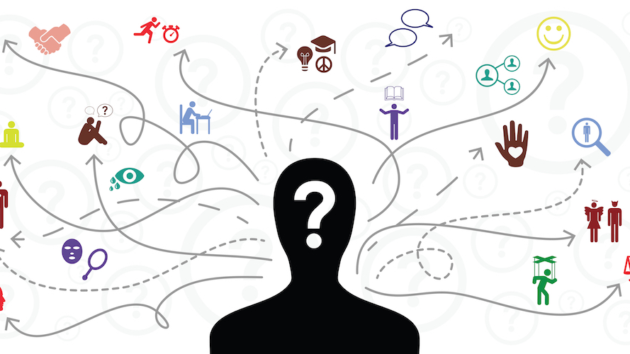
What’s our solution
An ML-powered web app that predicts accident severity based on the current conditions. It is trained with 25 Thousand accident records over 2010-2021. More data means greater accuracy. The purpose of such a model is to be able to predict accidents based on the conditions that will be more prone to accidents, and therefore take preventive measures. We will even try to locate more precisely future accidents in order to provide faster care and precautionary service.
We will train our model with multiple algorithms and only choose the best one with high accuracy. This will ensure that our model is as accurate as possible and can provide the most accurate predictions.

Slide 7
Objective
1. To study the causes of the accident by features extraction.
2. To understand the severity of the accident based on these features.
3. To classify it as fatal, grievous, simple injury or motor collision.
4. To carry out algorithms to predict the performance and accuracy of each.
5. To conclude the fastest algorithm.
6. To understand the effect of each feature on the accident and conclude how much is it responsible for the accident.

Slide 8
ASSUMPTIONS AND DEPENDENCIES
Data quality: The quality of the data used to train the model is critical. The data should be accurate, complete, and representative of the real world.
Bias: The model should be free of bias. The model should not be biased against any particular group of people.
Here are some of the assumptions and dependencies that we have to consider while creating an analysis model using machine learning:-
Model complexity
The complexity of the model should be appropriate for the data. A complex model may be more accurate, but it may also be more difficult to train and interpret.
Training data: The training data must be accurate and realistic. A wide range of potential accident-causing variables, such as driver behaviour, road conditions, and weather, should be included in the data.

Slide 9
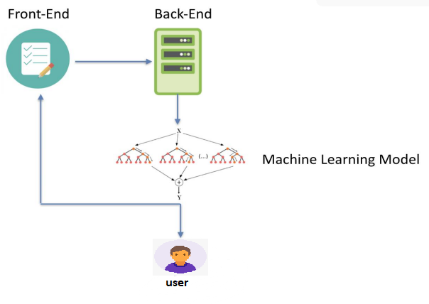
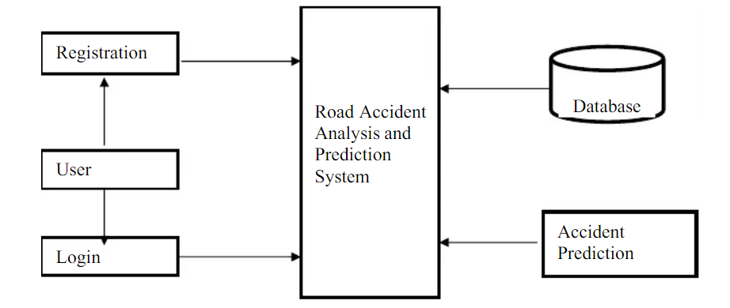
System architecture

Slide 10
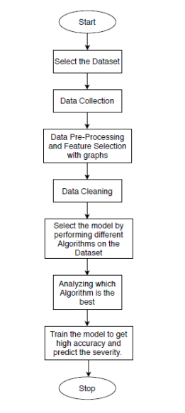
Data-flow Diagram

Slide 11
Implementation
We are now in the implementation phase of our project. This is where we take the ideas that we have developed and put them into action. We will be working closely with our team to make sure that the project is implemented smoothly and that all of the requirements are met. We are excited to see this project come to life and we are confident that it will be a success.

Slide 12
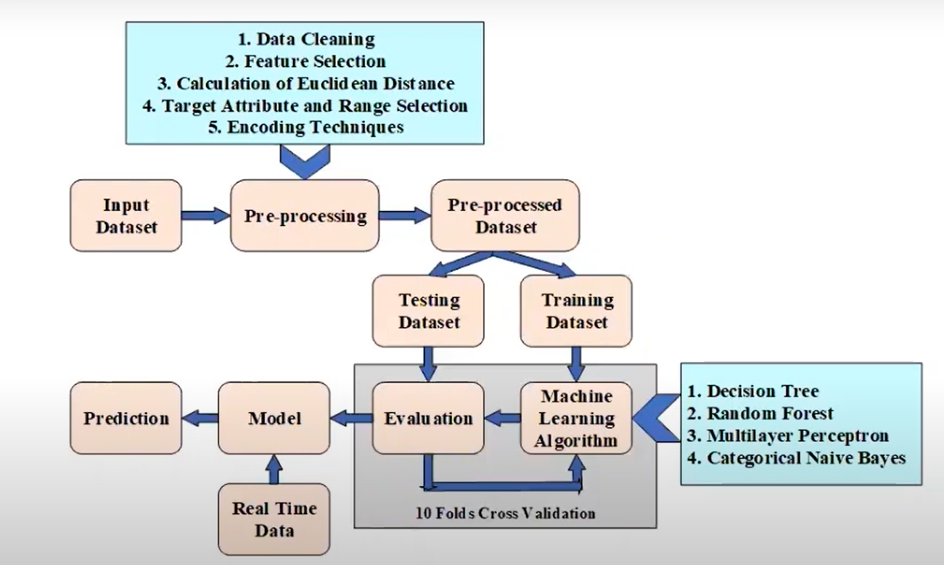
Overall ML model process

Slide 13
Data Mining:
DATA PRE-PROCESSING:
A key stage of the data mining process is data preparation. It is the process of preparing raw data for analysis by cleaning, formatting, and other changes.
We have used Python inbuilt library function to perform the cleaning and formatting of the dataset we have selected.
DATA GATHERING:
We will use a variety of sources to gather data for machine learning, including Kaggle. Kaggle is a great resource for finding high-quality data sets
Here are some of the steps involved in data mining. Which transform a data into something which can be understand by human and can be used in ML algorithms to build an model.
DATA VISUALIZATION:
The visual representation of data is known as data visualization. Data patterns and trends that would be challenging to spot would be made visible in this process.

Slide 14
Age band of driver
Vehicle type
Age of vehicle
Weather conditions
Day of week
Road surface conditions
Light conditions
Sex of driver
Season
Speed limit
Accident seriousness
FEATURE SELECTION:

Slide 15
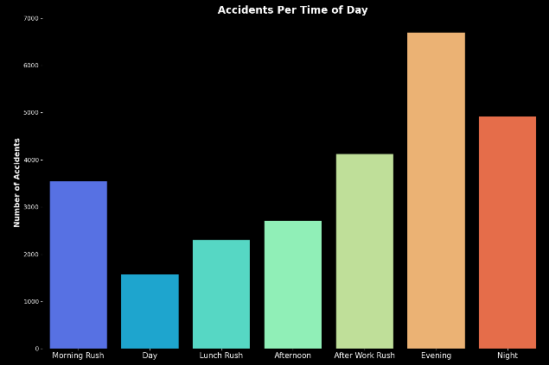
Time
we have Start Time & End Time for the timings of each accident. Start Time shows start time of the accident in local time zone. End Time shows end time of the accident in local time zone. End time here refers to when the impact of accident on traffic flow.
67% road accidents take place between 9AM and 9PM

Slide 16
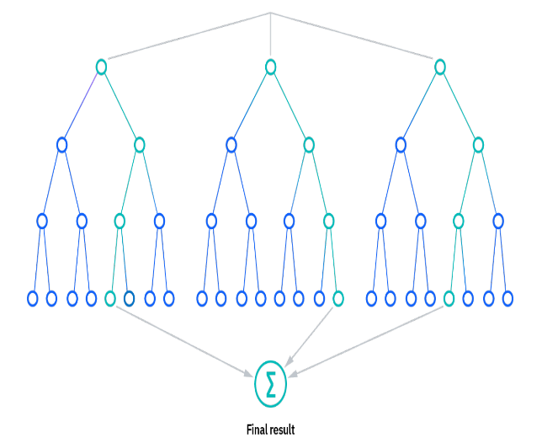
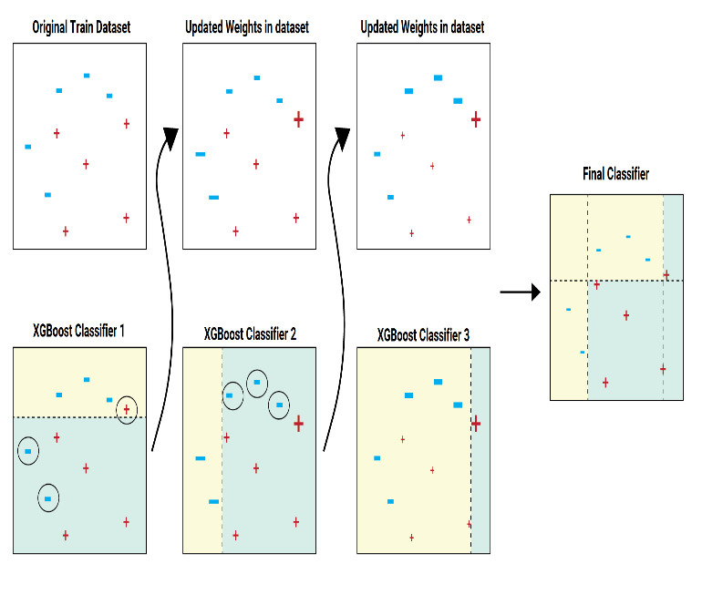
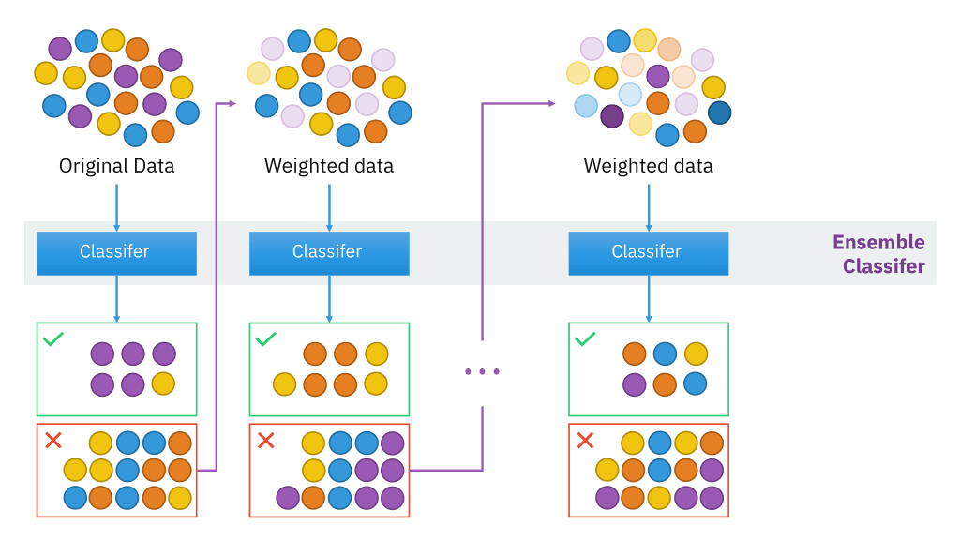
Xg Boost
XGBoost :
It is a gradient boosting algorithm that is known for its speed and accuracy. It is a popular choice for large-scale machine learning problems.
Model Used:
We have selected various models for model selection that can handle large amounts of data and are able to map complex relationships between the features
Random Forest Classifier:
It is an ensemble model that combines multiple decision trees to make predictions. It is a powerful model that can be used for a variety of tasks, including classification, regression, and clustering.
Gradient boosting classifier :
It is a supervised learning algorithm that can be used for classification tasks. It works by building a series of weak learners and then combining them to create a strong learner.

Slide 17
MODEL TRAINING :
We will first perform label encoding on the data to convert the categorical features into numerical features. We will then deal with the unbalanced categorical data of prediction. We will split the data set into train and test sets. We will then train the model on the train set and evaluate the model on the test set.
Algorithm | Accuracy
Random Forest Classifier | 82.40%
Gradient Boosting Classifier | 80.70%
SVC (Support Vector Machine) | 78.40%
K-Neighbors Classifier | 75.09%
Logistic Regression | 79.69%
Decision Tree Classifier | 79.69%
XGBoost | 80.90%
Model Evaluation:
Model evaluation is the process of assessing the quality of a machine-learning model. It involves using the evaluation data to measure the accuracy of the model.

Slide 18
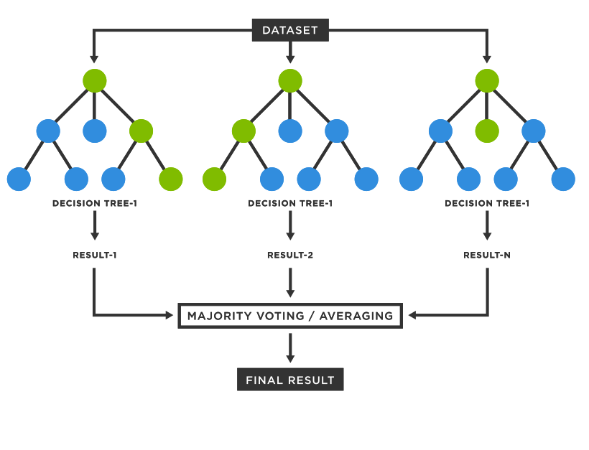
Random forest:
We found that the random forest classifier had the highest accuracy, precision, recall, and F1 scores. This means that the model was able to correctly predict the outcome of the test cases most often, and it was also able to identify positive cases accurately. We believe that the random forest classifier is the best model for our application because it has the highest accuracy and F1 scores. This means that the model is likely to make accurate predictions on new data.
Model Selection

Slide 19
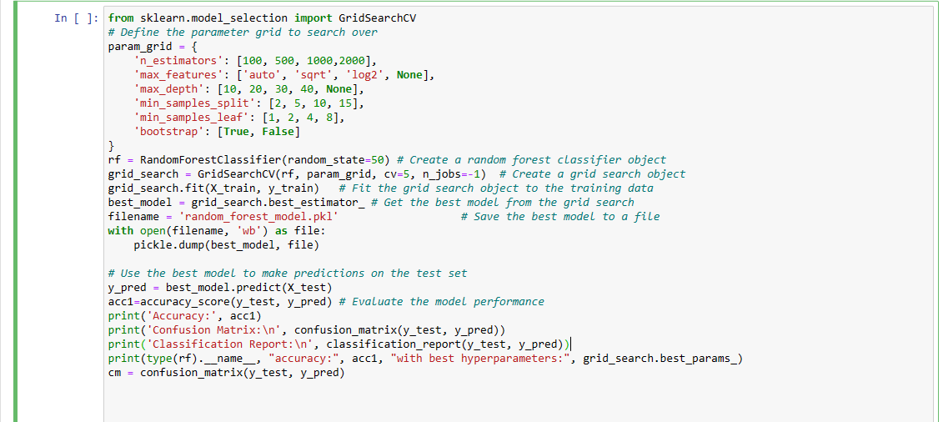
Model Training :
The above code is used to train a random forest classifier and evaluate its performance. The code first defines a parameter grid that specifies the values of the hyperparameters that will be searched over. The code then creates a random forest classifier object and a grid search object. The grid search object is then fit to the training data. The best model from the grid search is then saved to a file. The best model is then used to make predictions on the test set. The performance of the model is then evaluated using accuracy, confusion matrix, and classification report.

Slide 20
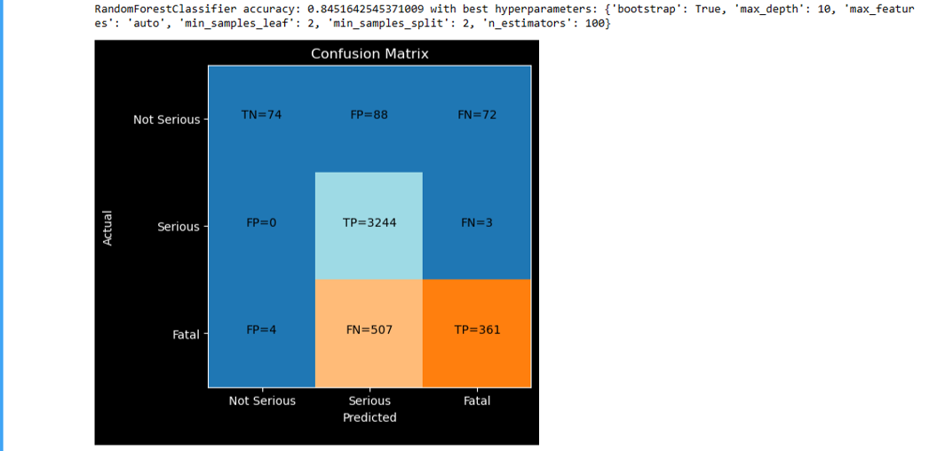
Hyper Parameter Tuning
Hyper parameter tuning is a process through which model’s efficiency and accuracy is increased by carefully finding the best values for the hyper parameters.
Grid search :
Grid search is a brute-force method for hyperparameter tuning. It involves creating a grid of all possible combinations of hyperparameter values and then evaluating each combination on a holdout dataset. The combination with the best performance is then chosen as the best hyperparameters for the model.

Slide 21
Stream Lit :
Stream lit library is a open source python library which helps a user to create web pages for Machine learning model
Model Deployment
Deployment :
The Stream lit library was used to deploy the model. With three categories—fatal, serious, and not serious—we used the pickle model of the classifier to predict the accident’s seriousness. By entering accident details and receiving a prediction of the severity, users can easily interact with the model on the webpage.
RENDER Host

Slide 22
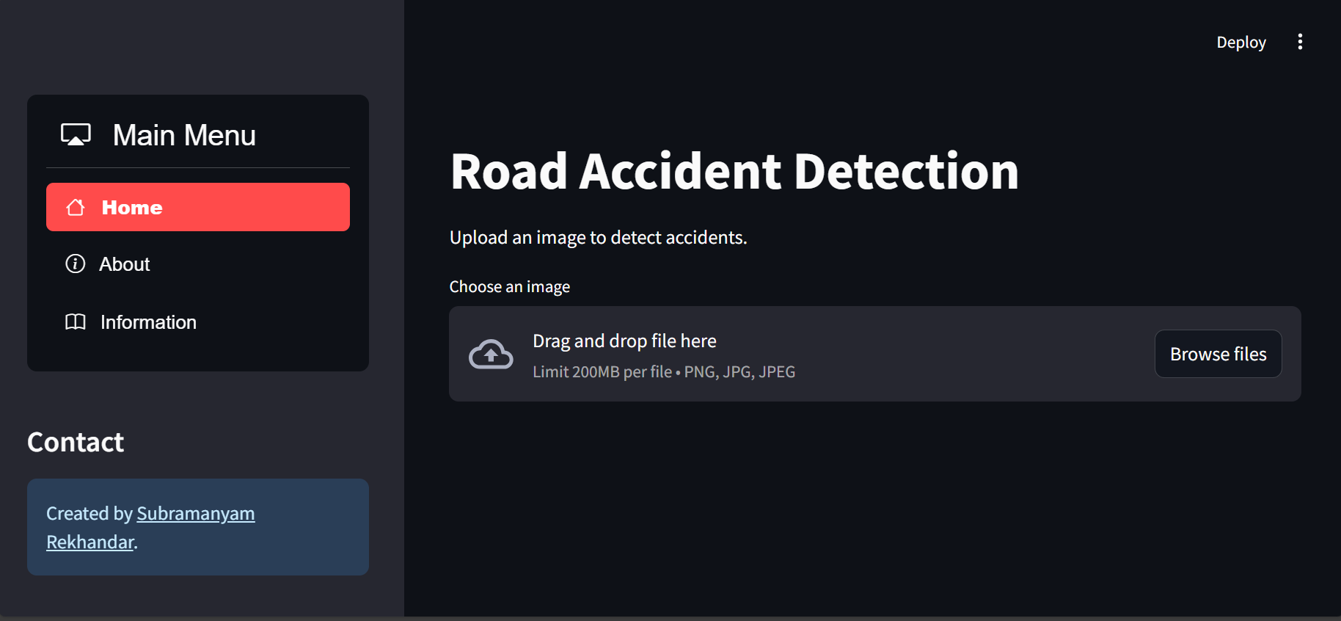
Intro to UI of project:
By entering the accident's characteristics on the main page of the application, users can forecast the accident's severity. To determine how serious an accident will be, the application uses a machine learning pickle model. The main page accepts the input from the user data and displays the predicted result. The main page also contains a navigation bar for the Home, Visual, and About pages.

Slide 23
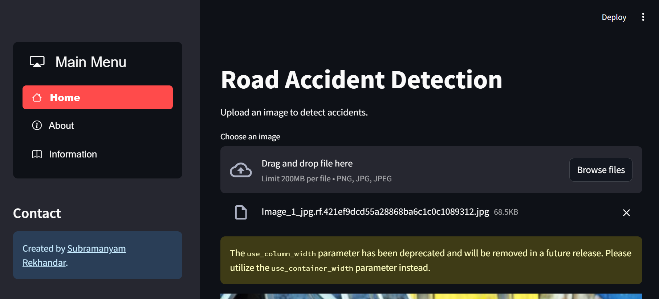
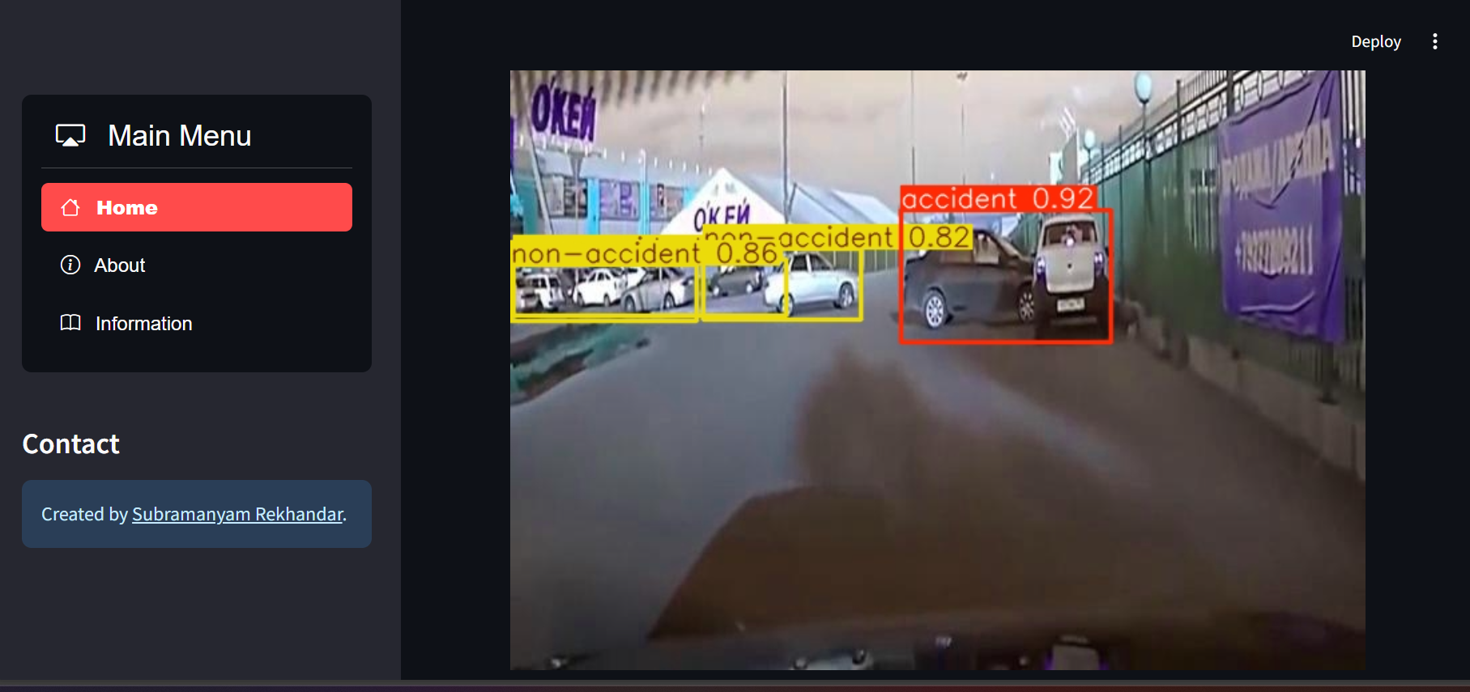
Visualization Tab:
The visual page of the application allows users to visualize the data. The data can be visualized in a variety of ways, including charts, graphs, and maps. The visual page allows users to explore the data and identify trends.

Slide 24
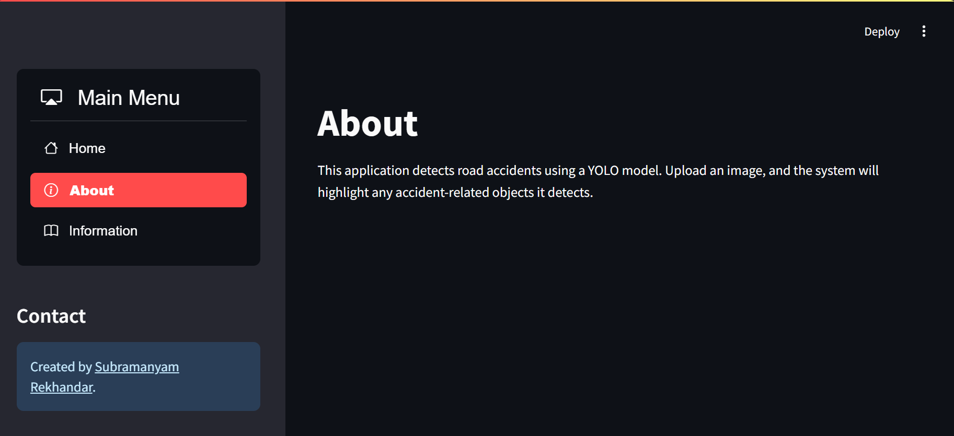
About Us Page:
The third page of the application provides information about the project. The page includes information about the goals of the project, the methods used, and the results of the project.

Slide 25
Conclusion:
In this project, we built a machine-learning model to predict the severity of road accidents. We collected a large and diverse dataset of accidents and used a variety of techniques to train the model. The model was able to predict the severity of accidents with a high degree of accuracy.
We think that by helping in accident prevention, our model has the potential to save lives. The organization may use the model to pinpoint locations where accidents are more likely to happen and then create prevention plans for those locations. We are excited to see how this approach is applied to save lives since we think it has the power to truly change the world.

Slide 26
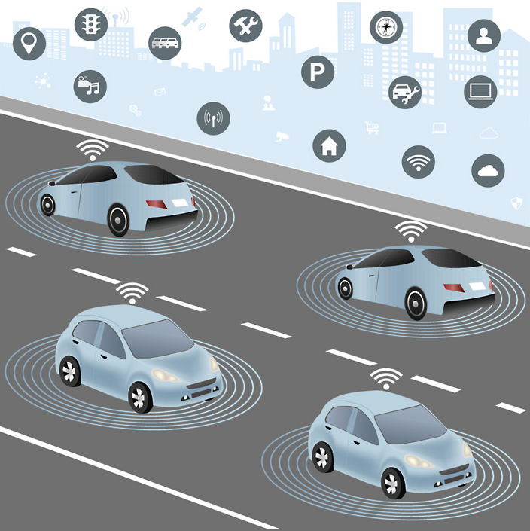
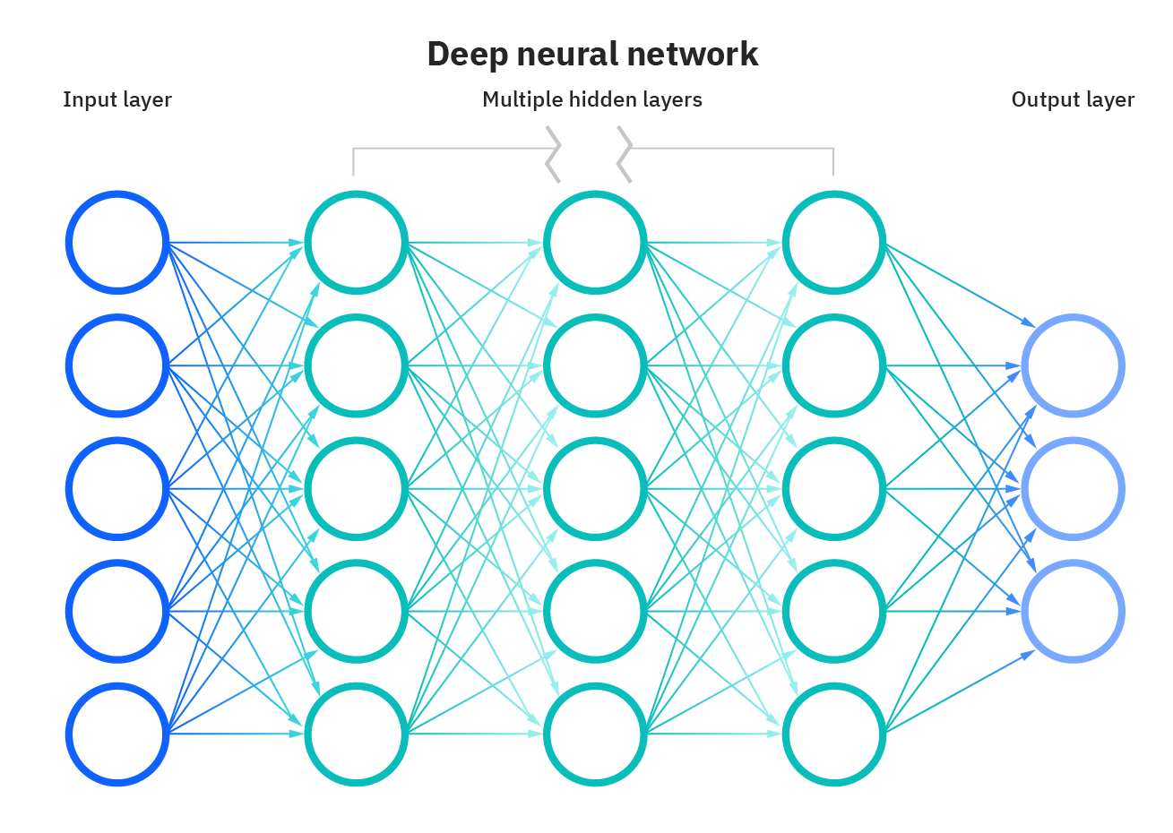
Future of this Project and improvement

Slide 27
References
https://ncrb.gov.in/sites/default/files/ADSI-2021/ADSI_2021_FULL_REPORT.pdf
https://data.gov.in/
https://timesofindia.indiatimes.com/
https://morth.nic.in/road-accident-in-india
https://colab.research.google.com/
https://docs.streamlit.io/
https://road-accident-ml.onrender.com/

Slide 28


